Slide 1
Lecture 3
Queues
Queues
Notes:
Queues
115/11/08 05:51

Slide 2

Queues
queue:
  Retrieves elements in the order they were added.
  First-In, First-Out ("FIFO")
  Elements are stored in order of
  insertion but don't have indexes.
  Client can only add to the end of the
  queue, and can only examine/remove
  the front of the queue.
Notes:
analogy: trays of food at the sizzler

Slide 3
The Queue ADT (§4.3)
The Queue ADT stores arbitrary objects
Insertions and deletions follow the first-in first-out scheme
Insertions are at the rear of the queue and removals are at the front of the queue
Main queue operations:
  enqueue(object): inserts an element at the end of the queue
  object dequeue(): removes and returns the element at the front of the queue
Auxiliary queue operations:
  object front(): returns the element at the front without removing it
  integer size(): returns the number of elements stored
  boolean isEmpty(): indicates whether no elements are stored
Exceptions
  Attempting the execution of dequeue or front on an empty queue throws an EmptyQueueException
Queues
Notes:
Queues
115/11/08 05:51

Slide 4
Queue Example
front
Operation Output
enqueue(5) -
 | 5
enqueue(3) -
 | 5 | 3
dequeue() 5
 | 3
enqueue(7) -
 | 3 | 7
dequeue() 3
 | 7
front() 7
 | 7
dequeue() 7
dequeue() “error”
isEmpty() true
enqueue(9) -
 | 9
enqueue(7) -
 | 9 | 7
size() 2
 | 9 | 7
enqueue(3) -
 | 9 | 7 | 3
enqueue(5) -
 | 9 | 7 | 3 | 5
dequeue() 9
 | 7 | 3 | 5
Linked Lists

Slide 5
Applications of Queues
Direct applications
  Waiting lists
  Access to shared resources (e.g., printer)
  Multiprogramming
Indirect applications
  Auxiliary data structure for algorithms
  Component of other data structures
Queues

Slide 6
Array-based Queue
Use an array of size N in a circular fashion
Two variables keep track of the front and rear
  f index of the front element
  r index immediately past the rear element
Array location r is kept empty
normal configuration
Q
0
1
2
f
r
wrapped-around configuration
Q
0
1
2
r
f
Queues

Slide 7
Queue Operations
We use the modulo operator (remainder of division)
Algorithm size()
return (N − f + r) mod N
Algorithm isEmpty()
return (f = r)
Q
0
1
2
f
r
Q
0
1
2
r
f
Queues

Slide 8
Queue Operations (cont.)
Algorithm enqueue(o)
if size() = N − 1 then
throw FullQueueException
else
Q[r] ← o
r ← (r + 1) mod N (r=(r+1)%N in Java)
Operation enqueue throws an exception if the array is full
This exception is implementation-dependent
Q
0
1
2
f
r
Q
0
1
2
r
f
Queues

Slide 9
Queue Operations (cont.)
Operation dequeue throws an exception if the queue is empty
This exception is specified in the queue ADT
Algorithm dequeue()
if isEmpty() then
throw EmptyQueueException
else
o ← Q[f]
f ← (f + 1) mod N
return o
Q
0
1
2
f
r
Q
0
1
2
r
f
Queues

Slide 10
Queue Interface in Java
public interface Queue {
public int size();
public boolean isEmpty();
public Object front()
throws EmptyQueueException;
public void enqueue(Object o);
public Object dequeue()
throws EmptyQueueException;
}
Java interface corresponding to our Queue ADT
Requires the definition of class EmptyQueueException
No corresponding built-in Java class
Queues

Slide 11
Application: Round Robin Schedulers
We can implement a round robin scheduler using a queue, Q, by repeatedly performing the following steps:
  e = Q.dequeue()
  Service element e
  Q.enqueue(e)
The Queue
1
.
Deque the
2
.
Service the
3
.
Enqueue the
next element
next element
serviced element
Shared
Service
Queues

Slide 12
Summary of Queues
Definition of Queues (basic)
Array implementation
Queues

Slide 13
Assignment 1: (due on Thursday of Week 6, Feb 25) Question (5 %) Implement the array-based Queue in Java assuming the interface is already given in Queue.java. Write a main method to have a Queue with the operations on side 4 of lecture 3.
Hint: Please look at ArrayStack.java as well as NodeQueue.java.
(Hand in during the lecture or drop a hard copy in Mail Box 75 at Floor 6 (Lift 9) outside CS Dept.)
Bonus: (Will add 1 point in the final score) Give the pseudo code for solving the Itinerary Generation Problem (week 1’s folder).
For bonus, your answer MUST be perfect. No partial mark will be given. This is a very hard problem at this stage (earlier semester). No need to do that if you do not have time.
Hint: Identify sub-problems to solve before give the pseudo code.
Queues

Slide 14




Part-B3
Linked Lists
Linked Lists
Notes:
Sequences
115/11/08 05:51

Slide 15

Introducing Linked Lists (continued)
Think of each element in a linked list as being an individual piece in a child's pop chain. To form a chain, insert the connector into the back of the next piece
© 2005 Pearson Education, Inc., Upper Saddle River, NJ. All rights reserved.

Slide 16
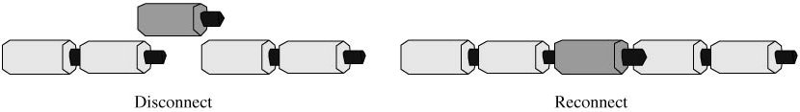
Introducing Linked Lists (continued)
Inserting a new piece into the chain
  breaking a connection and
  reconnecting the chain at both ends of the new piece.
© 2005 Pearson Education, Inc., Upper Saddle River, NJ. All rights reserved.

Slide 17
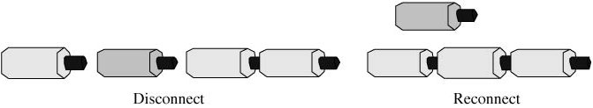
Introducing Linked Lists (continued)
Removal of a piece
  breaking its two connections
  removing the piece, and then reconnecting the chain.
© 2005 Pearson Education, Inc., Upper Saddle River, NJ. All rights reserved.

Slide 18
Singly Linked List (§ 4.4.1)
A singly linked list is a concrete data structure consisting of a sequence of nodes
Each node stores
  element
  link to the next node
next
elem
node
∅
A
B
C
D
Linked Lists

Slide 19
Inserting at the Head
head
1.Allocate a new node
∅
Rome
Scattle
Toronto
2. Update new element
(a)
head
3. Have new node point to old head
∅
Baltimore
Rome
Scattle
Toronto
4. Update head to point to new node
(b)
head
∅
Baltimore
Rome
Scattle
Toronto
Linked Lists
(c)

Slide 20
Removing at the Head
head
∅
1.Update head to point to next node in the list
Baltimore
Rome
Scattle
Toronto
(a)
head
∅
2.Allow garbage collector to reclaim the former first node
Baltimore
Rome
Scattle
Toronto
(b)
head
∅
Rome
Scattle
Toronto
Linked Lists
(c)

Slide 21
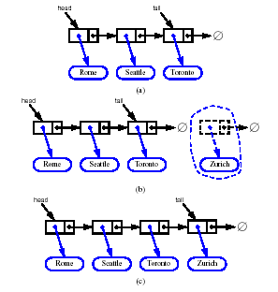



Inserting at the Tail
head
tail
1.Allocate a new node
∅
2. Insert new element
Rome
Scattle
Toronto
3. Have new node point to null
(a)
head
tail
∅
∅
4. Have old last node point to new node
Rome
Scattle
Toronto
Zurich
5. Update tail to point to new node
(b)
head
tail
∅
Rome
Scattle
Toronto
Zurich
Linked Lists
(c)

Slide 22
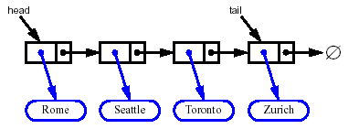
Removing at the Tail
Removing at the tail of a singly linked list is not efficient!
There is no constant-time way to update the tail to point to the previous node
The interface of data structure list is in List.java.
The implementation is in NodeList.java. But it uses DNode.java. Actually, it is doubly linked list.
Linked Lists

Slide 23
Linked Lists
bat •
cat •
sat •
vat NULL

Slide 24
Insertion
bat •
cat •
sat •
vat NULL
mat •
Compare this with the insertion in arrays!

Slide 25
Deletion
bat •
cat •
mat •
sat •
vat NULL
dangling
reference

Slide 26
The Node Class for List Nodes
(the file is source/Node.java)
public class Node {
// Instance variables:
private Object element;
private Node next;
/** Creates a node with null references to its element and next node. */
public Node() {
this(null, null);
}
/** Creates a node with the given element and next node. */
public Node(Object e, Node n) {
element = e;
next = n;
}
// Accessor methods:
public Object getElement() {
return element;
}
public Node getNext() {
return next;
}
// Modifier methods:
public void setElement(Object newElem) {
element = newElem;
}
public void setNext(Node newNext) {
next = newNext;
}
}
Linked Lists

Slide 27
Stack with a Singly Linked List
We can implement a stack with a singly linked list
The top element is stored at the first node of the list
The space used is O(n) and each operation of the Stack ADT takes O(1) time
nodes
t
∅
elements
Linked Lists

Slide 28
Queue with a Singly Linked List
We can implement a queue with a singly linked list
  The front element is stored at the first node
  The rear element is stored at the last node
The space used is O(n) and each operation of the Queue ADT takes O(?) time
r
nodes
f
∅
elements
Linked Lists

Slide 29
List ADT (§ 5.2.3)
The List ADT models a sequence of positions storing arbitrary objects
It establishes a before/after relation between positions
Generic methods:
  size(), isEmpty()
Accessor methods:
  first(), last()
  prev(p), next(p)
Update methods:
  replace(p, e)
  insertBefore(p, e), insertAfter(p, e),
  insertFirst(e), insertLast(e)
  remove(p)
Linked Lists

Slide 30
Doubly Linked List
A doubly linked list provides a natural implementation of the List ADT
Nodes implement Position and store:
  element
  link to the previous node
  link to the next node
Special trailer and header nodes
prev
next
elem
node
header
nodes/positions
trailer
elements
Linked Lists

Slide 31
Insertion
We visualize operation insertAfter(p, X), which returns position q
p
A
B
C
p
A
B
q
C
X
p
q
A
B
X
C
Linked Lists

Slide 32
Insertion Algorithm
Algorithm insertAfter(p,e):
Create a new node v
v.setElement(e)
v.setPrev(p) {link v to its predecessor}
v.setNext(p.getNext()) {link v to its successor}
(p.getNext()).setPrev(v) {link p’s old successor to v}
p.setNext(v) {link p to its new successor, v}
return v {the position for the element e}
Linked Lists

Slide 33
Deletion
We visualize remove(p), where p = last()
p
A
B
C
D
A
B
C
p
D
A
B
C
Linked Lists

Slide 34
Deletion Algorithm
Algorithm remove(p):
t = p.element {a temporary variable to hold the return value}
(p.getPrev()).setNext(p.getNext()) {linking out p}
(p.getNext()).setPrev(p.getPrev())
p.setPrev(null) {invalidating the position p}
p.setNext(null)
return t
Linked Lists

Slide 35
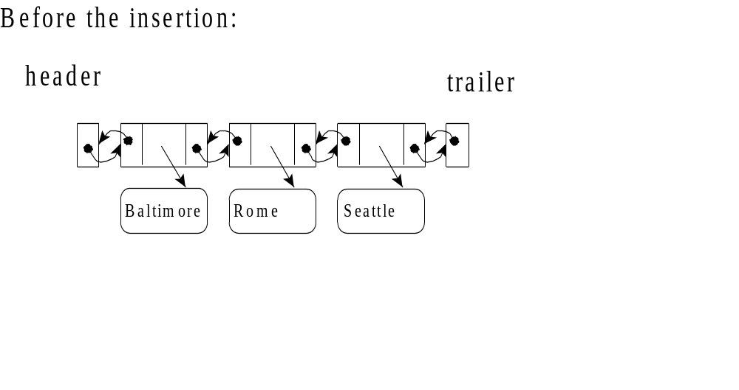
Insertion of an Element at the Head

Slide 36
Have a new node:
header
trailer
Baltimore
Rome
Seattle
Toronto

Slide 37
Update the links:
header
trailer
Baltimore
Rome
Seattle
Toronto

Slide 38
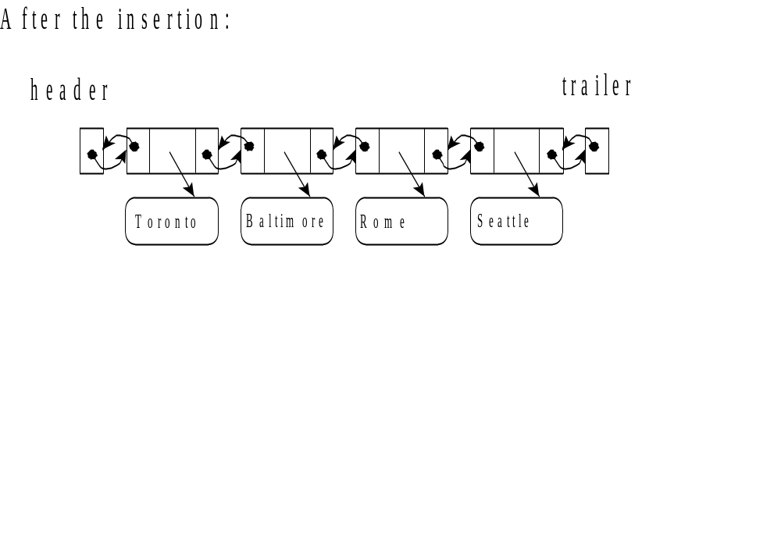

Slide 39
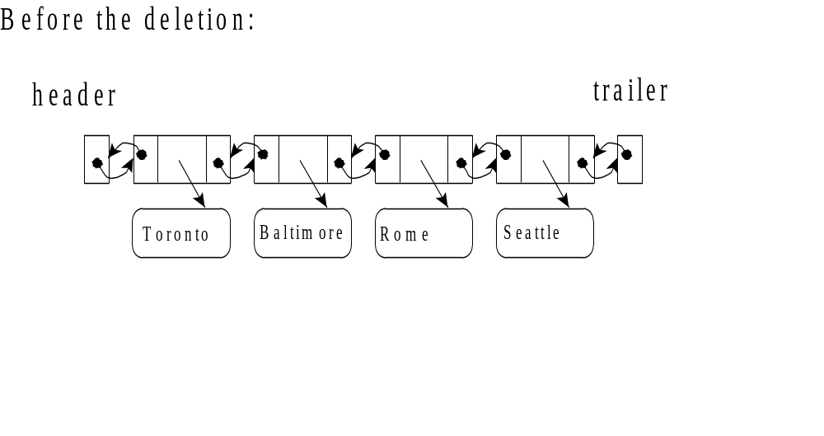
Deleting an Element at the Tail

Slide 40
Update the links:
header
trailer
Toronto
Baltimore
Rome
Seattle

Slide 41
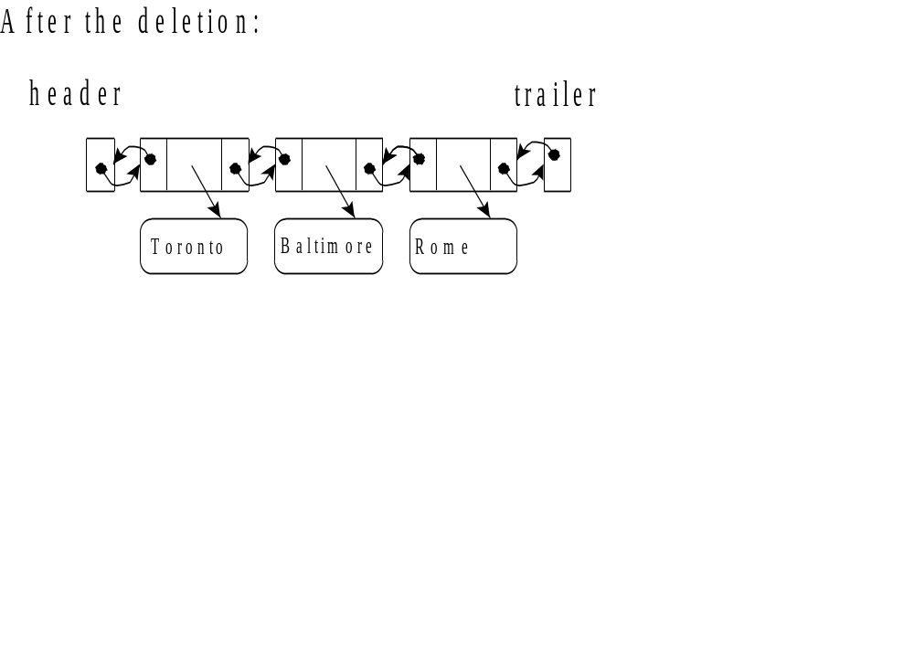

Slide 42
Performance
In the implementation of the List ADT by means of a doubly linked list
  The space used by a list with n elements is O(n)
  The space used by each position of the list is O(1)
  All the operations of the List ADT run in O(1) time
  Operation element() of the
  Position ADT runs in O(1) time
Linked Lists

